Slide 1


Lecture 12
Produced by Dr. Worldwide
Welcome to the 305
~
~

Slide 2

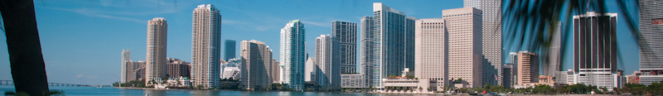
Shortest Route Problem
Dijkstra’s algorithm for identifying the shortest route
Step 1: Select the node with the shortest route from the origin
Step 2: Create a permanent set that includes the origin and the node chosen in the 1st step
Step 3: Identify all nodes that are adjacent to the nodes in the permanent set
Step 4: Select the node with the shortest route from the group of nodes adjacent to the nodes in the permanent set. Add the chosen node to the permanent set
Step 5: Repeat the 3rd and 4th steps until all nodes are in the permanent set

Slide 3

Shortest Route Problem
We want to reformulate the problem as a linear program
The origin in the shortest route problem can be thought of as a single supply node
The other nodes can be thought of as demand nodes
Source has supply equal to the number of nodes in the graph minus one (itself)
Each demand node requires a single unit
Distance between nodes corresponds to transportation cost of that edge
To reduce the number of variables, we assume units only flow in the direction of a higher node number
Ignore $x_{ij} if i≥j$

Slide 4
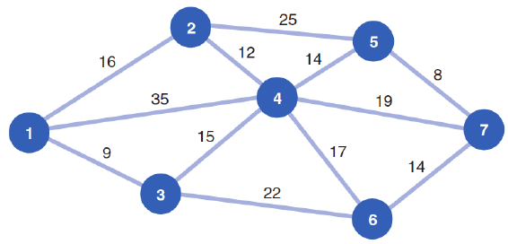
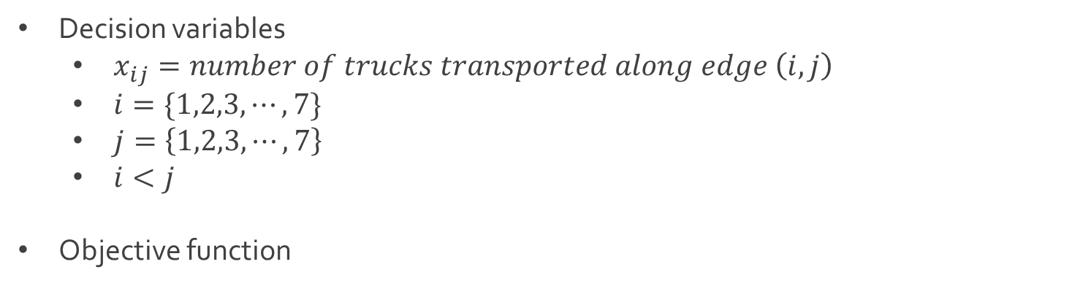
Ex: Shortest Shipping Route
Decision variables
$x_{ij}=number of trucks transported along edge \left(i,j\right)$
$i=\{1,2,3,⋯, 7\}$
$j=\left\{1,2,3,⋯,7\right\}$
$i<j$
Objective function
$$Z=16x_{12}+35x_{14}+9x_{13}+12x_{24}$$
$+15x_{34}+25x_{25}+14x_{45}+17x_{46}$
$+22x_{36}+8x_{57}+19x_{47}+14x_{67}$

Slide 5
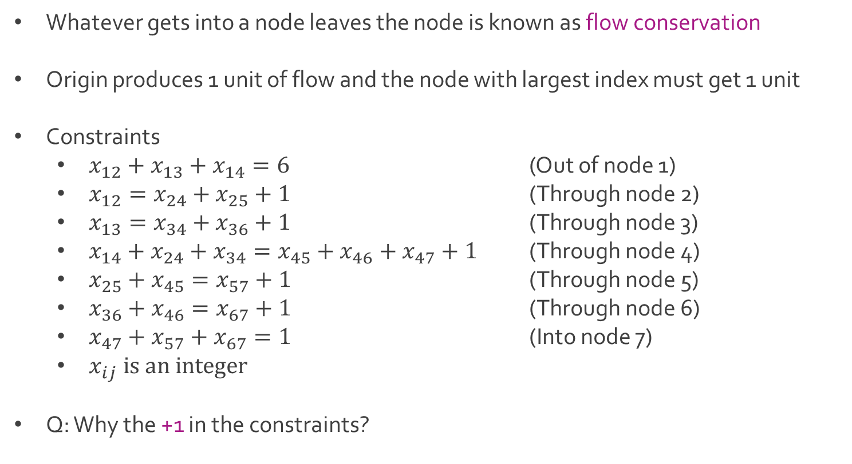
Ex: Shortest Shipping Route
Whatever gets into a node leaves the node is known as flow conservation
Origin produces 1 unit of flow and the node with largest index must get 1 unit
Constraints
$x_{12}+x_{13}+x_{14}=6$ (Out of node 1)
$x_{12}=x_{24}+x_{25}+1$ (Through node 2)
$x_{13}=x_{34}+x_{36}+1$ (Through node 3)
$x_{14}+x_{24}+x_{34}=x_{45}+x_{46}+x_{47}+1$ (Through node 4)
$x_{25}+x_{45}=x_{57}+1$ (Through node 5)
$x_{36}+x_{46}=x_{67}+1$ (Through node 6)
$x_{47}+x_{57}+x_{67}=1$ (Into node 7)
$x_{ij} is an integer$
Q: Why the +1 in the constraints?

Slide 6
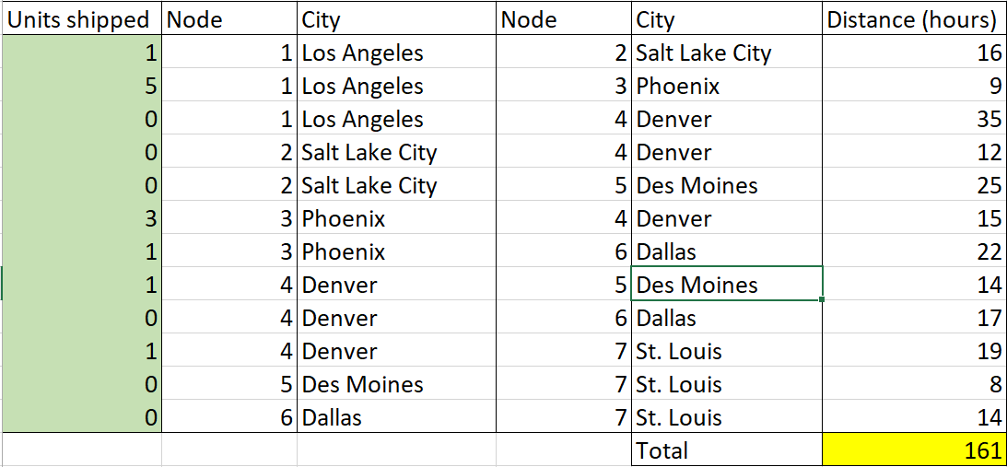
Ex: Shortest Shipping Route
Download ShortestRoute.xlsx from course website from link Sheet 1
Look at tab titled One-to-All

Slide 7
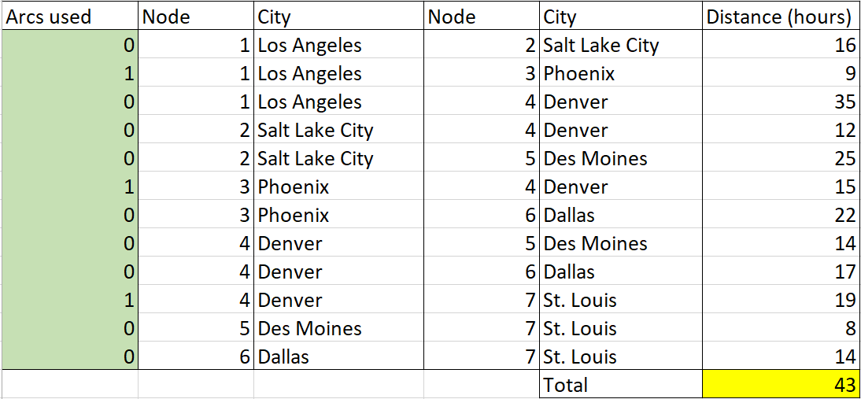
Ex: Shortest Shipping Route
Look at tab titled One-to-One
Q:What is the difference between One-to-All and One-to-One?

Slide 8
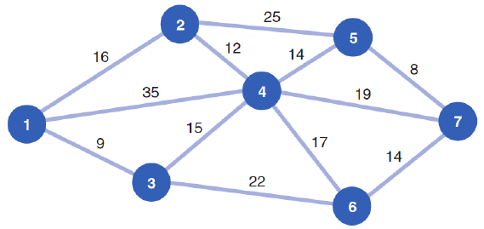
Shortest Route Problem
Assumed that we had supply at origin (node 1) to fulfill demand at all other nodes
Suppose we only wanted to get one unit from the origin to one destination node
We must modify the constraints to reflect a supply and demand of one

Slide 9
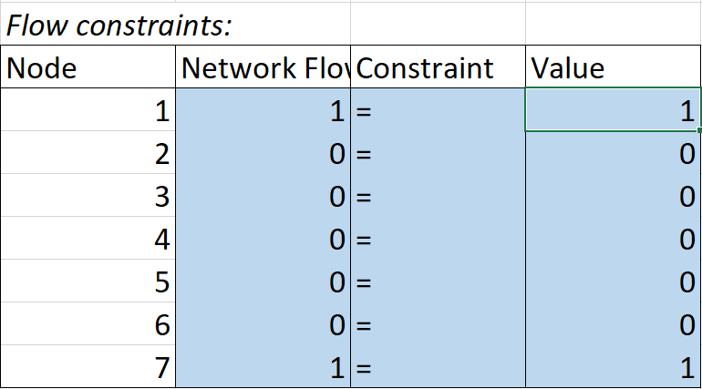
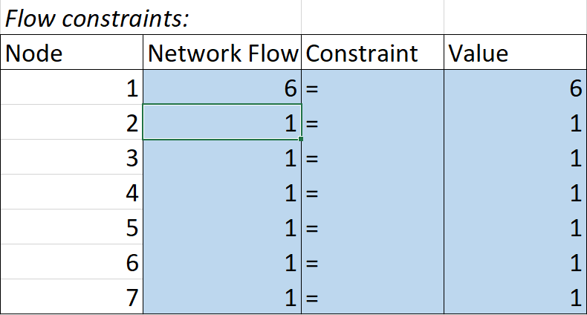

Ex: Shortest Shipping Route
Modification of constraints
One origin to one destination
One origin to many destinations
Difference Between In and Out
$$x_{12}−x_{24}−x_{25}$$

Slide 10
Shortest Route Problem
Assumed that edges had direction from West (node 1) to East (nodes 2-7)
Suppose direction doesn’t matter
We must consider both directions for each branch

Slide 11

Ex: Shortest Shipping Route
Decision variables for undirected network
$x_{ij}=number of trucks transported along edge \left(i,j\right)$
$i=\{1,2,3,⋯, 7\}$
$j=\left\{1,2,3,⋯,7\right\}$
$i<j$ or $i>j$
Objective function for undirected network
$$Z=16{(x}_{12}+x_{21})+3{5(x}_{14}+x_{41})+9{(x}_{13}+x_{31})+12(x_{24}+x_{42})$$
$+ 15{(x}_{34}+x_{43})+25\left(x_{25}+x_{52}\right)+14\left(x_{45}+x_{54}\right)+17{(x}_{46}+x_{64})$
$+ 22(x_{36}+x_{63})+8\left(x_{57}+x_{75}\right)+19(x_{47}+x_{74})+14\left(x_{67}+x_{76}\right)$

Slide 12
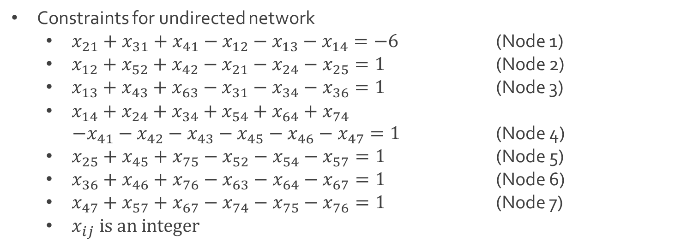
Ex: Shortest Shipping Route
Constraints for undirected network
$x_{21}+x_{31}+x_{41}−x_{12}−x_{13}−x_{14}=−6$ (Node 1)
$x_{12}+x_{52}+x_{42}−x_{21}−x_{24}−x_{25}=1$ (Node 2)
$x_{13}+x_{43}+x_{63}−x_{31}−x_{34}−x_{36}=1$ (Node 3)
$x_{14}+x_{24}+x_{34}+x_{54}+x_{64}+x_{74}$
$−x_{41}−x_{42}−x_{43}−x_{45}−x_{46}−x_{47}=1$ (Node 4)
$x_{25}+x_{45}+x_{75}−x_{52}−x_{54}−x_{57}=1$ (Node 5)
$x_{36}+x_{46}+x_{76}−x_{63}−x_{64}−x_{67}=1$ (Node 6)
$x_{47}+x_{57}+x_{67}−x_{74}−x_{75}−x_{76}=1$ (Node 7)
$x_{ij} is an integer$

Slide 13
Ex: Shortest Shipping Route
Download ShortestRoute-1.xlsx from course website from link Sheet 2
The tabs One-to-All-Directed and One-to-One-Directed contain previous results
Closely examine the tabs One-to-All-Undirected and One-to-One-Undirected
Q: What do you notice is the same between directed and undirected problems?
Q: What do you notice is different between directed and undirected problems?
Q: What is the purpose of the number 1,000 in the distance matrix?

Slide 14




The End
Dale

